Slide 1
Constraint-Based Modeling of Metabolic Networks
Tomer Shlomi
School of Computer Science, Tel-Aviv University, Tel-Aviv, Israel
March, 2008

Slide 2
Outline
Introduction to metabolism and metabolic networks
Constraints-based modeling
Mathematical formulation and methods
  Linear programming
Our research
  Integrated metabolic/regulatory networks
  Human tissue-specific metabolic behavior

Slide 3
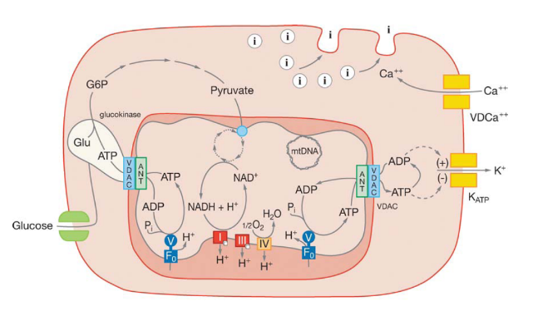
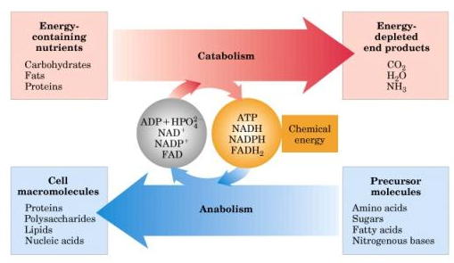
Metabolism
Metabolism is the totality of all the chemical reactions that operate in a living organism.
Catabolic reactions
Breakdown and produce energy
Anabolic reactions
Use energy and build up essential cell components
Notes:
רק רגע לפני שמתחילים נגדיר מהו מטבוליזם ולמה הוא חשוב:
-מכלול התהליכים הכימיים המתרחשים בתא.
-הבסיס לקיום גדילה של התא והשרדתו בתנאי הסביבה.
- חילוף החומרים שלנו- או בעצם מכלול התהליכים המפרקים חומרים מהסביבה , מפיקים אנרגיה ובונים מולקלות חיוניות לתא כגון : נוק' ח"א ח.שומן ועוד.

Slide 4
Why Study Metabolism?
It’s the essence of life..
Tremendous importance in Medicine:
  In born errors of metabolism cause acute symptoms and even death on early age
  Metabolic diseases (obesity, diabetics) are major sources of morbidity and mortality
  Metabolic enzymes and their regulators gradually becoming viable drug targets
Bioengineering:
  Efficient production of biological products
The best understood cellular network
Notes:
למה למוד מטבוליזם באדם?
בגלל מחלות בעיקר:
1. In born error of metabolism הן מחלות מטבלויות מולדות הנגרמות בד"כ מפגיעה בפעילות אנזים מטבולי בעלות סימפטומים קשים ואף יכולות לגרום למוות בגיל מוקדם.
2. אחת המחלות הנפוצות ביותר בארה"ב ובעולם המערבי obesity וסוכרת הנגרמת בעקבותיה והיא נחשבת לאחד מהגורמים העיקרים לתחלואה ומוות בארה"ב.
3. השיטות העקרייות לטיפול במחלות מטבוליות ( מלבד טיפול פסיכולוגי וספורט במקרה של obesity) היא targeting של אינזימים מטבולים שידועים כשותפים בתהליך המטבולי הפגוע או בתהליכים שברצוננו למנוע מבעדם לפעול: לדוגמא כשיטה לטיפול ב obesity נפגע בפעולתו של הטרנספורטר שאחראי על הספיגה של שומנים ממערכת העיכול ובכך ננסה לעצור את תהליך ההשמנה.
4. אחת הבעיות במחקר של מחלות מטבוליות הוא הצורך לחקור סוגי תאים שונים ברקמות שונות שהתנהגותם המטבולית היא שונה.
הבעיה העקרית היא שקשה לערוך ניסויים in vitro בסוגי תאים שונים מאחר וקשה לגדל תרביות תאים מסויימים במעבדה.
כאן נכנס הנושא של למידה על התנהגות מטבולית בצורה חישובית והיתרונות שהוא מציע.

Slide 5
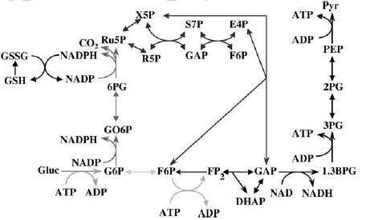
Metabolites and Biochemical Reactions
Metabolite: an organic substance, e.g. glucose, oxygen
Biochemical reaction: the process in which two or more molecules (reactants) interact, usually with the help of an enzyme, and produce a product
Most of the reactions are catalyzed by enzymes (proteins)
Glucose + ATP
Glucokinase
Glucose-6-Phosphate + ADP

Slide 6
Modeling the Network Function: Kinetic Models
Dynamics of metabolic behavior over time
  Metabolite concentrations
  Enzyme concentrations
  Enzyme activity rate – depends on enzyme concentrations and metabolite concentrations
  Solved using a set of differential equations
Impossible to model large-scale networks
  Requires specific enzyme rates data
  Too complicated

Slide 7
Modeling the Network Function
Dynamical systems
Requires kinetic constants (mostly unknown)
Kinetic models
Approx. kinetics
Accuracy
Optimization theory
Constrained space of possible, steady-state network behaviors
Metabolic
Constraint-based models
Probabilistic models, discrete models, etc’
Conventional functional models
Scale
Graph theory
Structural network properties: degree distribution, centrality, clusters, etc’
Topological analysis
PPI
Notes:
So how do we go about modeling the function encoded in these networks?
There is a wide range of models that can be placed on a axis that reflects a tradeoff between the accuracy and scalability
On one end, we have kinetic that rely on dynamical systems theory. These models provides a dynamic description.. However these models are applicable only for..
On the other extreme, we have topological analysis that rely on graph theory.
These models treat the network as a static graph and look for structural properties – centrality of elements or isolated clusters
However, although applicable for large-scale networks their insight on the network function is limited
In between these two extremes, there are numerous “functional models”. However due to the complexity of the system, and missing data, these models are usually very non-accurate.
A unique exception is constraint-based modelling that is usually applied to model metabolic networks.
Almost all of these models have been applied to model the different networks.
For PPI networks, as very little is known on the overall function of the network, most of the analysis is performed is topological

Slide 8
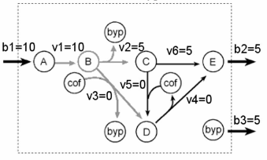
Constraint Based Modeling
Provides a steady-state description of metabolic behavior
  A single, constant flux rate for each reaction
  Ignores metabolite concentrations
  Independent of enzyme activity rates
Assume a set of constraints on reaction fluxes
Genome scale models
Flux rate:
μ-mol / (mg * h)

Slide 9
Constraint Based Modeling
Find a steady-state flux distribution through all
biochemical reactions
Under the constraints:
  Mass balance: metabolite production and consumption rates are equal
  Thermodynamic: irreversibility of reactions
  Enzymatic capacity: bounds on enzyme rates
  Availability of nutrients

Slide 10
Additional Constraints
Transcriptional regulatory constraints (Covert, et. al., 2002)
  Boolean representation of regulatory network
Energy balance analysis (Beard, et. al., 2002)
  Loops are not feasible according to thermodynamic principles
Reaction directionality
  Depending on metabolite concentrations
FBA solution space
Meaningful
solutions

Slide 11
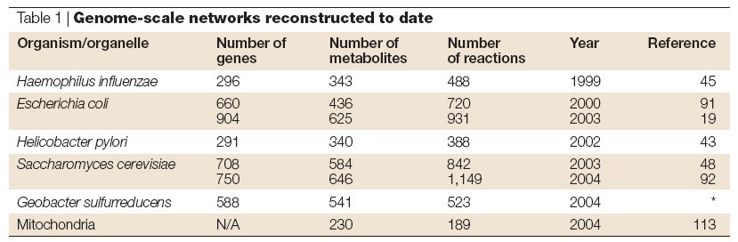
Metabolic Networks
Biochemistry
Cell
Physiology
Genome
Annotation
Inferred
Reactions
Network Reconstruction
Metabolic Network
Analytical Methods

Slide 12
Constraint-based modeling applications
Phenotype predictions:
  Growth rates across media
  Knockout lethality
  Nutrient uptake/secretion rates
  Intracellular fluxes
  Growth rate following adaptive evolution
Bioengineering:
  Strain design – overproduce desired compounds
Biomedical:
  Predict drug targets for metabolic disorders
Studying an array of questions regarding:
  Dispensability of metabolic genes
  Robustness and evolution of metabolic networks

Slide 13
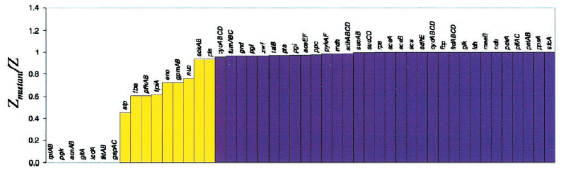
Phenotype Predictions: Knockout Lethality in E.coli
86% of the predictions were consistent with the experimental observations

Slide 14
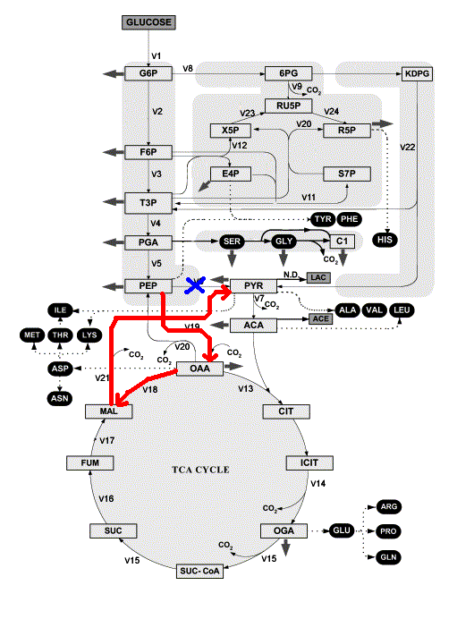
Phenotype Predictions: Flux Predictions
Predict metabolic fluxes following gene knockouts
Search for short alternative pathways to adapt for gene knockouts (Regulatory On/Off Minimization)

Slide 15
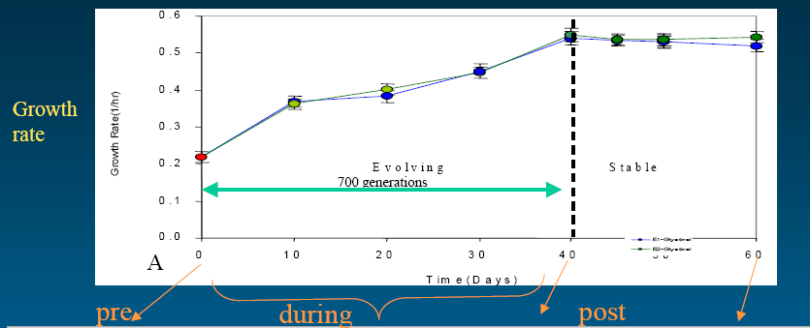
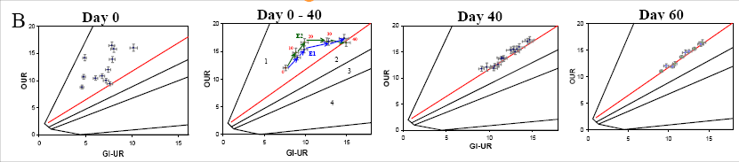
Phenotype Predictions: Evolving Growth Rate

Slide 16
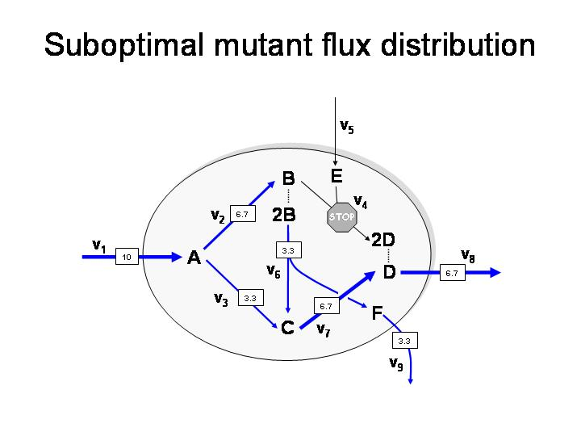
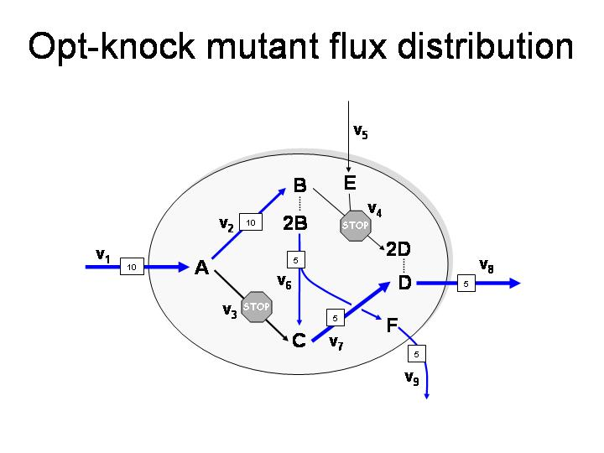
Strain design: maximizing metabolite production rate
Identify a set of gene whose knockout increases the production rate of some metabolite
The knockout of reaction v3 increases the production rate of metabolite F

Slide 17
Constraint-Based Modeling: Mathematical Representation

Slide 18
Mathematical Representation
Stoichiometric matrix – network topology with stoichiometry of biochemical reactions
Glucokinase
Glucose + ATP
Glucokinase
Glucose-6-Phosphate + ADP
Glucose -1
ATP -1
G-6-P +1
ADP +1
Mass balance
S·v = 0
Subspace of R
Thermodynamic
v_{i} > 0
Convex cone
Capacity
v_{i} < v_{max}
Bounded convex cone
n

Slide 19
Determination of Likely Physiological States
How to identify plausible physiological states?
Optimization methods
  Maximal biomass production rate
  Minimal ATP production rate
  Minimal nutrient uptake rate
Exploring the solution space
  Extreme pathways
  Elementary modes
Notes:
Optimization methods are used for several purposes,

Slide 20
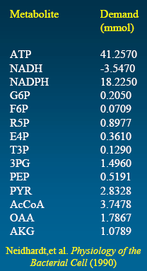
Biomass Production Optimization
Metabolic demands of precursors and cofactors required for 1g of biomass of E. coli
Classes of macromolecules:
Amino Acids, Carbohydrates
Ribonucleotides, Deoxyribonucleotides
Lipids, Phospholipids
Sterol, Fatty acids
These precursors are removed from the
metabolic network in the corresponding ratios
We define a growth reaction
Z = 41.2570 V_{ATP} - 3.547V_{NADH}+18.225V_{NADPH} + ….

Slide 21
Flux Balance Analysis (FBA)
Finds flux distribution with maximal growth rate
Biomass production rate represents growth rate
Solved using Linear Programming (LP)
  Max v_{gro}, - maximize growth
  s.t
  S∙v = 0, - mass balance constraints
  v_{min} ≤ v ≤ v_{max} - capacity constraints
growth
Fell, et al (1986), Varma and Palsson (1993)

Slide 22
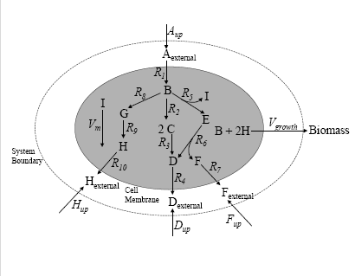
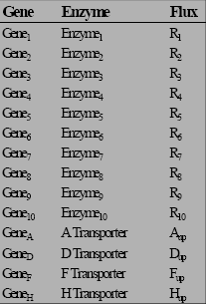
FBA Example (1)

Slide 23
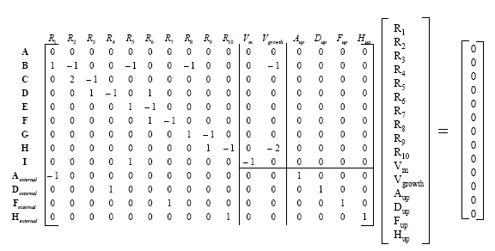
FBA Example (2)

Slide 24
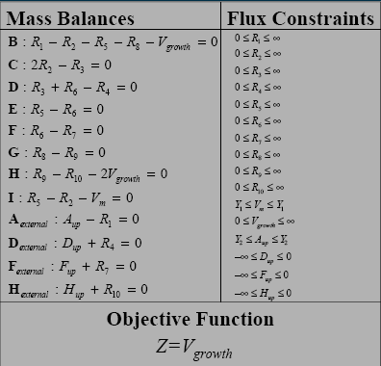
FBA Example (2)

Slide 25
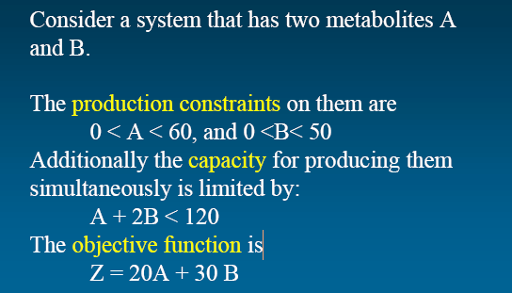
Linear Programming Basics (1)

Slide 26
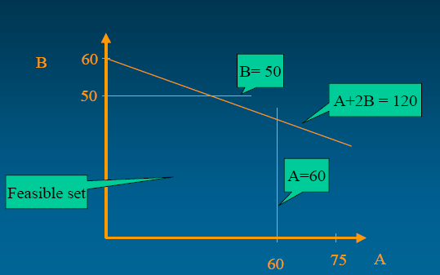
Linear Programming Basics (2)

Slide 27
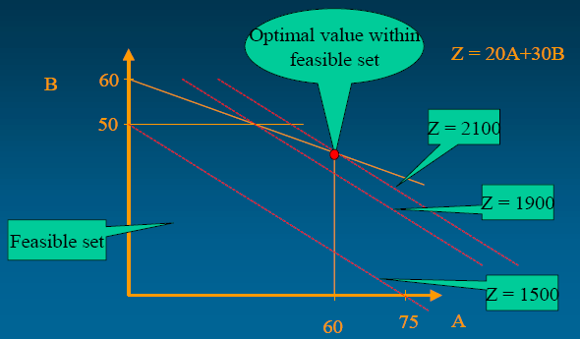
Linear Programming Basics (3)

Slide 28
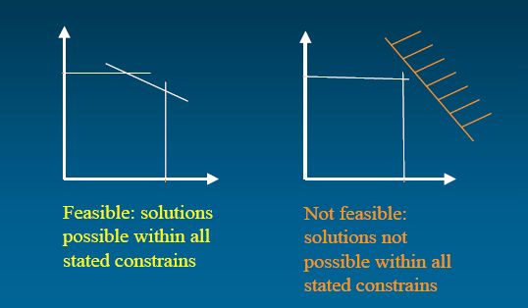
Linear Programming: Types of Solutions (1)

Slide 29
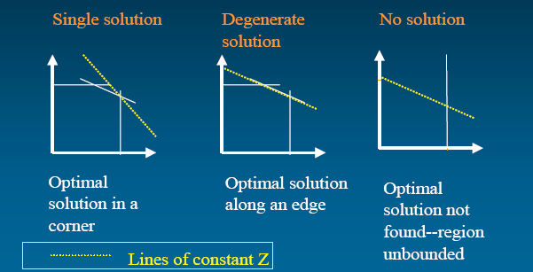
Linear Programming: Types of Solutions (2)

Slide 30
Linear Programming Algorithms
Simplex algorithm
  Travels through polytope vertices in the optimization direction
  Guaranteed to find an optimial solution
  Exponential running time in worse case
  Used in practice (takes less than a second)
Interior point
  Worse case running time is polynomial
Optimization

Slide 31
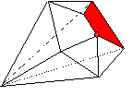
Exploring a Convex Solution Space
Linear programming may result in multiple alternative solutions
Alternative solutions represent different possible metabolic behaviors (through alternative pathways)
The solution space can be explored by various sampling and optimization methods
growth
growth

Slide 32
Topological Methods
Not biased by a statement of an objective
Network based pathways:
  Extreme Pathways (Schilling, et. al., 1999)
  Elementary Flux Modes (Schuster, el. al., 1999)
Decomposing flux distribution into extreme pathways
Extreme pathways defining phenotypic phase planes
Uniform random sampling

Slide 33
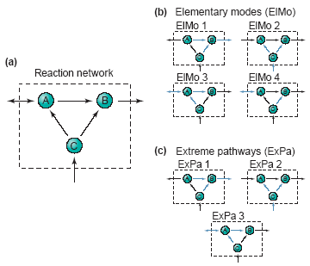
Extreme Pathways and
Elementary Flux Modes
Unique set of vectors that spans a solution space
Consists of minimum number of reactions
Extreme Pathways are systematically independent (convex basis vectors)
Notes:
A pathway is a metabolic state which satisfies stoichiometric and thermodynamic constrains.
Extreme pathways and elementary flux modes are both unique sets of pathways.
Both type of pathways are minimal – i.e. there is no other pathway with a subset of the reactions.
Only in extreme pathways the pathways are systematically independent. No EP can be described as a combination of the others. EP are the basic of the convex space.
Each metabolic state can be described as non-negative combination of EPs.
EP and EM are the same where all exchange fluxes are unidirectional.
Example network.
There was an ongoing debate on which method is better in describing the phenotypic potential of the network. In a recent (and not so convincing paper) of the main supporters of both methods it was agreed that:
The main advantage of EP is that there are far fewer of them in a typical network and that they have a mathematical justification being the basis of the convex space. EM are suitable for studying network properties such as redundancy as it includes all minimal pathways.

Slide 34
Our Research:
Integrating Metabolic and Regulatory Networks

Slide 35
Regulatory Constraints
CRP
FBA predicts that both Galactose and Glucose are simultaneously consumed when present in the media
When Glucose is present, the concentration of active CRP decreases and represses the expression of the GAL system
Boolean logic formulation:
GalK = Crp and NOT(GalR or GalS)
Galactose
Glucose
galK
Galactose-1-p
galT
Glucose-1-p
Glucose-6-p
Fructose-6-p
Notes:
In a growth media that consists of glucose as the sole carbon source, FBA predicts
2. If we add galactose to this media, FBA predicts.. Which is in contrast to real biology in which..
4. The effect of transcriptional regulation can be expressed using Boolean equations

Slide 36
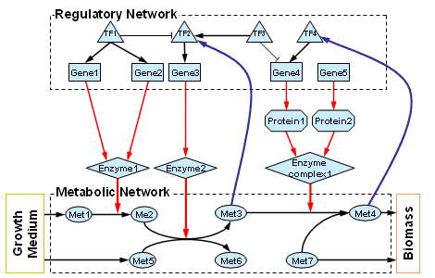
Integrated Metabolic/Regulatory Models
Genome-scale integrated model for E. coli (Covert 2004)
  1010 genes (104 TFs, 906 genes)
  817 proteins
  1083 reactions
Regulatory
state
(Boolean vector)
Metabolic
state
Notes:
The previous work of Covert et al., constructed a large-scale integrated model of e. coli. The module consists of two modules..
2. The model consists of a regulatory part - this part consists of TFs and genes and a set of Boolean regulatory equations
3. The metabolic part consists of a stoichiometric matrix..
4. The mutual effects
4. The functional state is consists of a Boolean regulatory state and a metabolic state

Slide 37
Research Objectives
Develop a method that finds regulatory/metabolic steady-state solutions and characterizes the space of possible solutions in a large-scale model
Study the expression and metabolic activity profiles of metabolic genes in E. coli under multiple environments
  Quantify the the extent to which different levels of metabolic and transcriptional regulatory constraints determine metabolic behavior
  Identify genes whose expression pattern is not optimally tuned for cellular flux demand

Slide 38
The Steady-state Regulatory FBA Method
SR-FBA is an optimization method that finds a consistent pair of metabolic and regulatory steady-states
Based on Mixed Integer Linear Programming
Formulate the inter-dependency between the metabolic and regulatory state using linear equations
g
v
0
1
1
…
v₁
v₂
v₃
…
Regulatory
state
Metabolic
state
g₁ = g₂ AND NOT (g₃)
g₃ = NOT g₄
…
Stoichiometric matrix
S·v = 0
v_{min} < v < v_{max}
Notes:
We developed a method - “Steady-state regulatory FBA” (or SR-FBA for short) that finds..
It is based on MILP, which is an optimization method that involves both continuous and integer variables
The method finds a metabolic state, which is flux vector v with continuous values (representing..), and a regulatory state which is a vector g with Boolean values.
The metabolic state v:
This flux vector should satisfy the same stoichiometric, thermodynamic and flux capacity constraints as standard FBA problems.
These constraints are formulated based on a stoichiometric matrix which his a mathematical representation of the topology of the metabolic network and the stoichiometry of the biochemical interactions
The regulatory state g:.
This vector should satisfy the set of regulatory equations defined in the model.
These Boolean equations are can be directly converted to a set of linear equations.
Without getting into the details it involves a recursive iterations of the structure of the equations and adding variables and constraints to represent simple Boolean predicates.
Finally, we need to formulate the constraints that the regulatory state imposes on the metabolic state and vice versa. And I’ll show these constraints in the following slide.

Slide 39





SR-FBA: Regulation → Metabolism
The activity of each reaction depends on the presence specific catalyzing enzymes
For each reaction define a Boolean variable r_{i} specifying whether the reaction can be catalyzed by enzymes available from the expressed genes
Formulate the relation between the Boolean variable r_{i} and the flux through reaction i
g₁
g₂
g₃
if
then
Gene1
Gene2
Gene3
else
Protein2
Protein3
AND
Enzyme1
Enzyme
complex2
OR
r₁
Met1
Met3
Met2
r₁ = g₁ OR (g₂ AND g₃)
Notes:
Let’s start with the constraints that regulation imposed on metabolism
The activity of each enzyme (i.e., whether it carries non-zero flux) depends on the availability of a corresponding enzyme
For example
, this reaction.. can be catalyzed if..
This logic can be represented a the Boolean equation..
And these equations are formulated as linear equations as described in the previous slide
In addition we need to constraint the flux through this reaction to zero if there is no enzyme that catalyzes it.
That is, we have a rule in the form of “if r_{i}=0 then” which involved both Boolean and continuous variables.
This can be done using these constraints
Auxiliary variables

Slide 40





SR-FBA: Metabolism → Regulation
The presence of certain metabolites activates/represses the activity of specific TFs
For each such metabolite we define a Boolean variable m_{j} specifying whether it is actively synthesized, which is used to formulate TF regulation equations
TF2 = NOT(TF1) AND (MET3 OR TF3)
if
then
else
TF1
TF2
TF3
Me1
Met3
m_{j}
Met2
Met4
Notes:
In the other direction we have the metabolic state imposing constraints on the regulatory state – that is, the presence of a certain metabolite can activate/repress the activity of TFs
For example:
the presence of metabolite met3 activates TF2
Specifically, we see that TF2 is activated when TF1 is not expressed, MET3 is present or TF3 is activated.
The value of mj is determined based on the following rule..
This rule can be formulated via these linear constraints
With these constraints we complete the definition of the MILP problem which given a specific growth medium finds a consistent pair of a metabolic and regulatory states

Slide 41
Basic Concepts:
Gene Expression and Activity
Genes are characterized by:
  Expression state – A gene can be expressed, not expressed.
  Metabolic activity state – Enzyme coding gene can be active, not active (i.e., carrying non-zero metabolic flux)
The expression and activity states are determined by considering the entire space of possible steady-state solutions:
  Adapt Flux Variability Analysis (Mahadevan 2003) for steady-state metabolic/regulatory solutions
  Genes may have undetermined expression or activity states –referred to as “potentially expressed” or “potentially active” states
 | Expression | Activity
TF | √ | -
Regulated gene | √ | √
Non-regulated gene | - | √
Notes:
The SR-FBA framework enables to characterize the expression and metabolic activity of a genes in different growth media:
The expression state is a Boolean value that specify whether a TF or regulated gene is expressed or not
The metabolic activity state is another Boolean value that specify whether an enzyme coding gene is metabolically active (i.e., carrying non-zero flux)
To determine the expression and metabolic activity state of genes it is not enough to consider a single metabolic/regulatory solution as multiple possible solutions may exists.
To explore the possible solutions space we adapt a method called Flux Variability Analysis (commonly used with simple FBA models) to explore the space of integrated metabolic/regulatory solutions.
We find that the state of some genes is undetermined in specific growth media. We refer to such genes as potentially expressed and potentially active.
“determined”

Slide 42
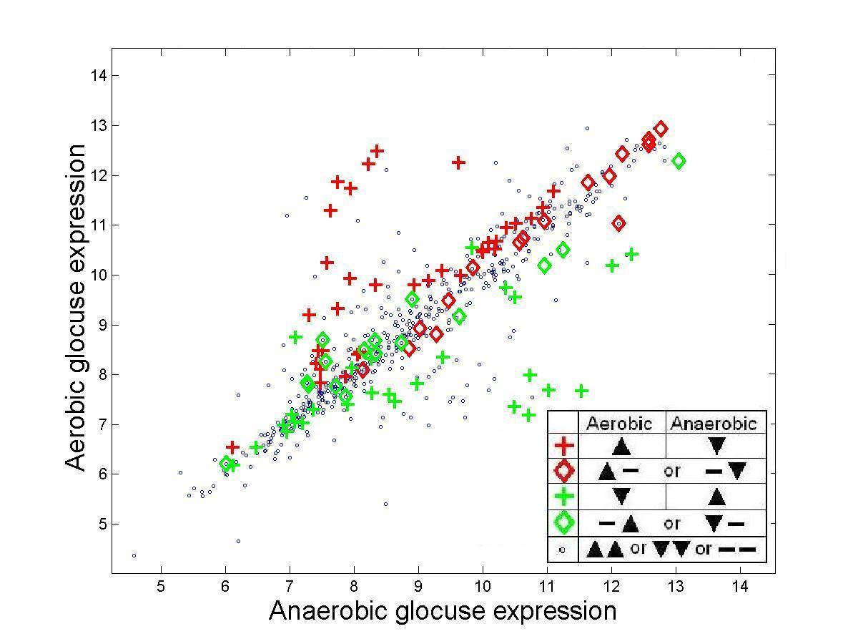
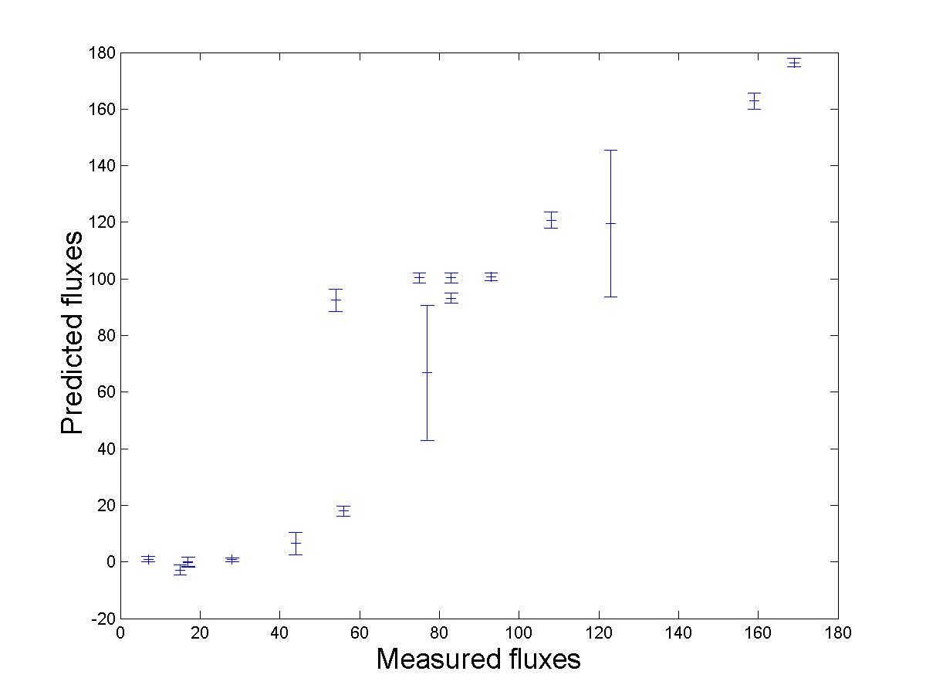
Results: Validation of Expression and Flux Predictions
Prediction of expression state changes between aerobic and anaerobic conditions are in agreement with experimental data (p-value = 10⁻³⁰⁰)
Prediction of metabolic flux values in glucose medium are significantly correlated with measurements via NMR spectroscopy (spearman correlation 0.942)
Notes:
As a first validation of SR-FBA we compare expression and flux predictions to experimental data
Starting with expression – we find that genes that are predicted to change their expression in diauxic shift have significant change in their measured expression in a corresponding experiment
Regarding specific flux measurements – we find that the fluxes in the central carbon metabolism of E. coli are significantly correlated with predictions (obtained with NMR spectroscopy) in glucose medium

Slide 43
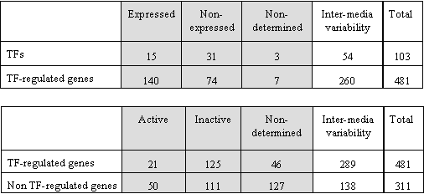
Gene Expression and Activity across Media
SR-FBA was applied on 103 aerobic and anaerobic growth media
Inter-media variability - undetermined expression or activity state in a given media
Intra-media variability - variable expression or activity states across media
A very small fraction of genes show intra-media variability in expression
A relatively high fraction of genes show intra-media variability in flux activity
Gene expression is likely to be more strongly coupled with environmental condition than reaction’s flux activity
Notes:
Next, we applied SR-FBA to predict genes expression and activity state across 103 different aerobic and anaerobic growth media
Some genes are predicted to have a constant expression or activity state across all conditions – these genes mostly depend on the availability of nutrients that are not includes in any of the simulated growth media
The remaining genes either exhibit inter or intra-media variability:
Inter-media variability means that they have different expression or activity states across different growth media
Intra-media variability means that they have undetermined expression or activity state within a same media (i.e., suggesting that states are feasible)
The statistics show that:
regarding expression states, a relatively small fraction of genes have with intra-media variability compared with inter-media variability
regarding activity states, a relatively high fraction of genes have intra-media variability
This testifies that gene expression is “more strongly coupled with environmental conditions than the reactions' flux activity. “

Slide 44
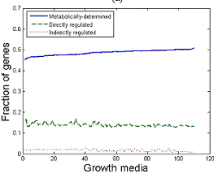
The Functional Effects of Regulation on Metabolism
Metabolic constraints determine the activity of 45-51% of the genes depending of growth media (covering 57% of all genes)
The integrated model determines the activity of additional 13-20% of the genes (covering 36% of all genes)
  13-17% are directly regulated (via a TF)
  2-3% are indirectly regulated
The activity of the remaining
30% of the genes is undetermined
Notes:
Next, we set of quantify the extent to which different levels of metabolic and transcriptional regulatory constraints determine metabolic behavior
To do that, we measured the fraction of enzyme coding genes whose flux activity state is determined when considering a simple FBA model without the transcriptional regulatory constraints, compared to the fraction of genes determined in the integrated model
We find that the activity state of 45-51% of the genes (across media) is determined when using only the metabolic model
The integrated model account for additional 13-20% of the genes (across media) covering a total of 36% of the genes.
13-17% are directly regulated – that is, their activity state is determined based on a specific TF regulates them
An additional 2-3% are indirectly regulated – they are not associated with a TF, but their state is determined by combining regulatory and metabolic constraints
Around metabolic activity state of 30% of the genes is left undetermined.
This may be the results of missing constraints in the model – i.e., post transcriptional regulatory constraints
Or, it may be that the activity state of these genes is simply undetermined, and different cells exhibit different metabolic state

Slide 45
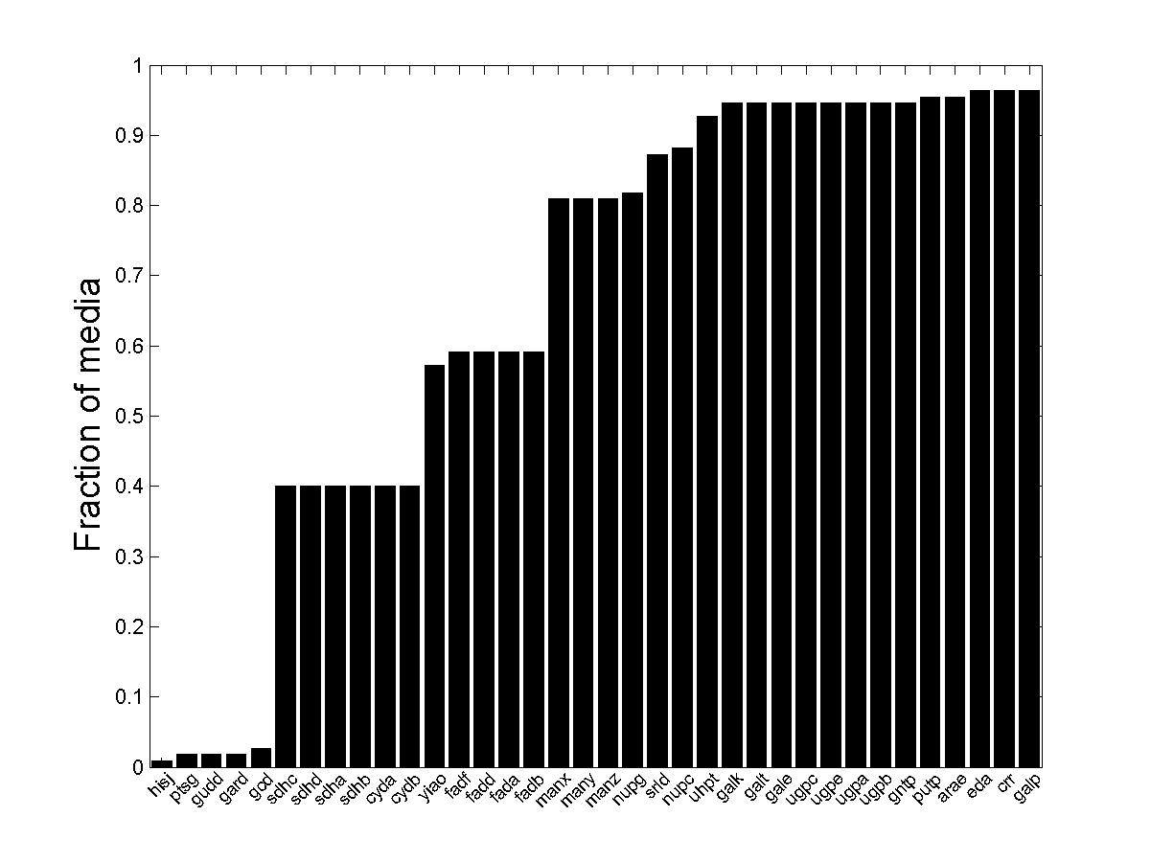
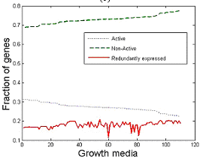
Redundant Expression of Metabolic Genes
Previous works have shown only a moderate correlation between expression and metabolic flux (Daran, 2003)
How does regulatory constraints match these flux activity states?
  An active gene must be expressed
  A non-active gene may “redundantly expressed”
36 genes are redundantly expressed in at least one medium
Notes:
Next, we set to Identify genes whose expression pattern is not optimally tuned for cellular flux demand
Previous work have shown that there exist only a moderate correlation between expression and metabolic flux
The integrated model, predicting both expression and metabolic activity of enzyme coding genes, enable to directly test the correlation between the two
An active gene (that carry non-zero metabolic flux )must be expressed
A gene that is non-active may be expressed – and we refer to this scenario as “redundantly expressed”
The figure shows the active genes, the non-active genes and the redundantly expressed genes
Overall, we find 36 redundantly expressed genes – the figure shows the fraction of media in which they are redundantly expressed

Slide 46
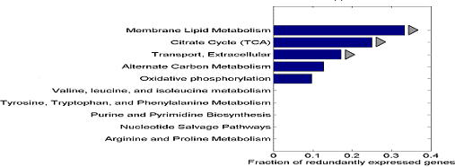
Validating Redundantly Expressed Genes
Several transporter affected by Crp are predicted to be redundantly expressed in media lacking glucose
Fatty acid degradation pathway is predicted to be redundantly expressed in many aerobic conditions without glycerol
We find that 12 genes that are predicted to be redundantly expressed in a certain media have significantly high expression in these media compared to media in which they are predicted to be non-expressed
Notes:
For example, several transporters affected by CRP are predicted to be redundantly expressed in media lacking glucose. For example:
Transporters of arabinose and gluconate are expressed when glucose is not present in the media even in media that lack these nutrients.
A fatty acid

Slide 47
SR-FBA Summary
We developed a method that finds regulatory/metabolic steady-state solutions and characterizes the space of possible solutions in a large-scale model
We quantified the extent to which different levels of constraints determined metabolic behavior
  45-51% of the genes - metabolic constraints
  13-20% of the genes - regulatory constraints
We identified 36 genes that are “redundantly expressed”, i.e., expressed even though the fluxes of their associated reactions are zero
SR-FBA enables one to address a host of new questions concerning the interplay between regulation and metabolism
SR-FBA code is available via WEB: http://www.cs.tau.ac.il/~shlomito/SR-FBA

